Slide 1
Unit 6 PreLive
Andrew Leppla

Slide 2
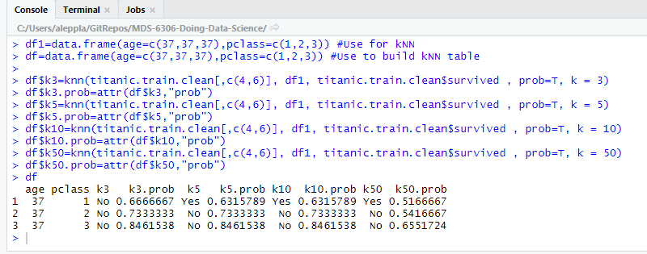
Part 1 – Predict your Titanic survival based on age and class: I could have survived in 1st class, otherwise not so much…
Notes:
library(jsonlite)
library(curl)
#I had an error trying to use getURL, so I used this instead:
titanic.url = readLines(curl(url="https://public.opendatasoft.com/api/records/1.0/search/?dataset=titanic-passengers&rows=2000&facet=survived&facet=pclass&facet=sex&facet=age&facet=embarked"))
titanic.json = fromJSON(titanic.url)
titanic.df = titanic.json$records$fields
#Inspect the training data
dim(titanic.df) #891 rows = passengers
titanic.train=titanic.df[order(titanic.df$passengerid),] #sort data by Passenger ID
head(titanic.train) #matches the titanic_train.csv on github
summary(titanic.train$age) #NA values present
summary(titanic.train$pclass) #Looks good
#Remove NA's from age
titanic.train.clean = titanic.train %>% filter(!is.na(age))
summary(titanic.train.clean$age)
#Classify Survival for my age by class
df1=data.frame(age=c(37,37,37),pclass=c(1,2,3)) #Use for kNN
df=data.frame(age=c(37,37,37),pclass=c(1,2,3)) #Use to build kNN table
df$k3=knn(titanic.train.clean[,c(4,6)], df1, titanic.train.clean$survived , prob=T, k = 3)
df$k3.prob=attr(df$k3,"prob")
df$k5=knn(titanic.train.clean[,c(4,6)], df1, titanic.train.clean$survived , prob=T, k = 5)
df$k5.prob=attr(df$k5,"prob")
df$k10=knn(titanic.train.clean[,c(4,6)], df1, titanic.train.clean$survived , prob=T, k = 10)
df$k10.prob=attr(df$k10,"prob")
df$k50=knn(titanic.train.clean[,c(4,6)], df1, titanic.train.clean$survived , prob=T, k = 50)
df$k50.prob=attr(df$k50,"prob")
df

Slide 3
Part1 - Classify the 332 (418 – 86 NA’s) randomly selected passengers in the test set
> summary(titanic.knn)
No Yes
218 114
Notes:
#Classify the 418 random passengers from the test set
##Import, inspect, and clean the test set
titanic.test=read.csv('C:/Users/aleppla/GitRepos/MDS-6306-Doing-Data-Science/Unit 6/titanic_test.csv',header=T)
summary(titanic.test[,5]) #NA's present for Age (col5)
summary(titanic.test[,2]) #Class (col2) looks good
titanic.test1=titanic.test %>% filter(!is.na(titanic.test$Age))
summary(titanic.test1[,5])
titanic.knn=knn(titanic.train.clean[,c(4,6)], titanic.test1[,c(5,2)], titanic.train.clean$survived , prob=T, k = 5)
summary(titanic.knn)

Slide 4
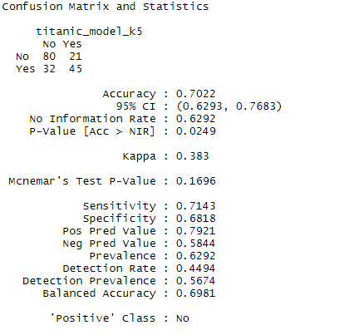
Part 1 – Confusion Matrix
Acc = (80+45)/(80+45+21+32) = 0.7022
Misclass. = 1- Acc. = 0.2978
No = “Positive”, Yes = “Negative”
Sens. [,No] = 80/(80+32) = 0.7143
Prob. of a true positive vs. a false negative
(like power vs. type II error)
Spec. [,Yes] = 45/(21+45) = 0.6818
Prob. of a true negative vs. a false positive (like confidence vs. type I error)
Notes:
#Confusion Matrix
#Split into training and test sets
set.seed(1)
splitPerc = .75
trainIndices = sample(1:dim(titanic.train.clean)[1],round(splitPerc * dim(titanic.train.clean)[1]))
titanic_train = titanic.train.clean[trainIndices,]
titanic_test = titanic.train.clean[-trainIndices,]
titanic_model_k3=knn(titanic_train[,c(4,6)], titanic_test[,c(4,6)], titanic_train$survived , prob=T, k = 3)
confusionMatrix(table(titanic_test$survived,titanic_model_k3))
titanic_model_k5=knn(titanic_train[,c(4,6)], titanic_test[,c(4,6)], titanic_train$survived , prob=T, k = 5)
confusionMatrix(table(titanic_test$survived,titanic_model_k5))
titanic_model_k10=knn(titanic_train[,c(4,6)], titanic_test[,c(4,6)], titanic_train$survived , prob=T, k = 10)
confusionMatrix(table(titanic_test$survived,titanic_model_k10))

Slide 5
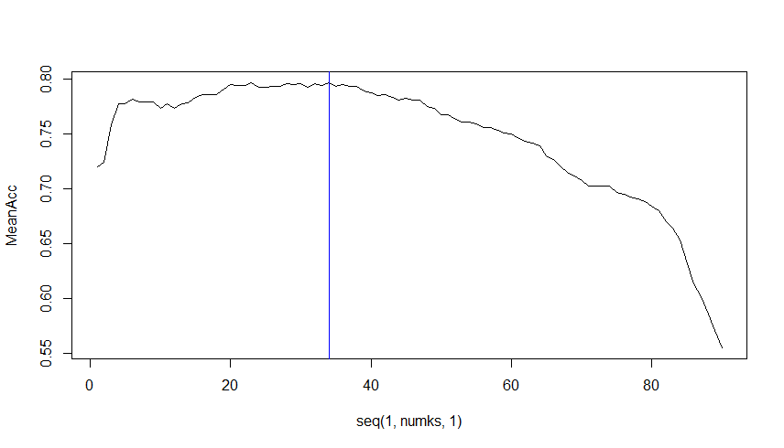
Part 2 – Iris Multinomial kNN : k=34 gives the maximum accuracy
> which.max(MeanAcc)
[1] 34
> max(MeanAcc)
[1] 0.7964444
Notes:
#Use a 70 - 30 train/test split to use cross validation to
#tune the hyperparameter k
# Loop for many k and the average of many training / test partition
set.seed(1)
iterations = 100
numks = 90
splitPerc = .70
masterAcc = matrix(nrow = iterations, ncol = numks)
for(j in 1:iterations)
{
trainIndices = sample(1:dim(iris)[1],round(splitPerc * dim(iris)[1]))
train = iris[trainIndices,]
test = iris[-trainIndices,]
for(i in 1:numks)
{
classifications = knn(train[,c(1,2)],test[,c(1,2)],train$Species, prob = TRUE, k = i)
table(classifications,test$Species)
CM = confusionMatrix(table(classifications,test$Species))
masterAcc[j,i] = CM$overall[1]
}
}
MeanAcc = colMeans(masterAcc)
plot(seq(1,numks,1),MeanAcc, type = "l")
abline(v=34,col="blue")
which.max(MeanAcc)
max(MeanAcc)

Slide 6
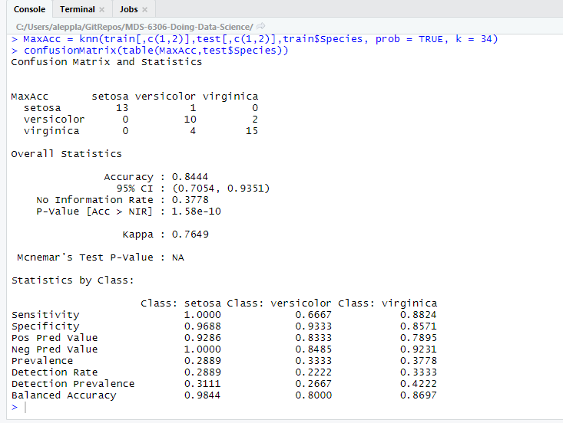
k=34 Confusion Matrix & Stats

Slide 7
Takeaways and Questions
Takeaways
It took me a minute to figure out and consistently remember Sensitivity and Specificity
I need to try to create some of these code loops independently rather than just adapt them
Scaling factors was a good lesson and a good watch-out for blindly using tools. I just realized I forgot to scale my factors in these analyses…
Questions
How many variables can reasonably be used for kNN modeling in higher dimensional space?
Does kNN in R automatically scale the variables?

